Slide 1

Talking to the outside world

Slide 2
Purpose of beam languages
Concurrency
Scalability
Expressiveness
Reliability

Slide 3
Reasons for talking to outside world
Mature External Libraries(ffmpeg,libsodium)
Hard Real Time/Speed
(emb. systems,audio/video processing)
Interface with old company/vendor code base
Developer familiarity with different language

Slide 4

Word To The Wise from Joe Armstrong creator of Erlang
Make It work
Make it beautiful
Make it fast
Make It work
Make it beautiful
Make it fast
Make It work
Make it beautiful
Make it

Slide 5

For those brave souls who choose to go outside the beam kingdom you have four spears to use :)
Ports
Nifs
Distributed erlang

Slide 6
Ports
A port is a byte oriented interface/middleman to an external program
The external program can run in another os process or be dynamically linked(dll) to the erlang runtime where it runs as part of the erlang runtime.In the second case its called a port driver/linkedin driver.
Port drivers are the most efficient way of talking to the beam vm.
But faulty port driver can cause the entire Erlang runtime system to leak memory, hang, or crash.Use with caution or as a last resort!!
In built applications which make use of ports in the beam use ports for opening network sockets(tcp,udp,etc..),monitoring state of the host operating system(memory,cpu,disk),get information/run commands on host operating system among other things

Slide 7
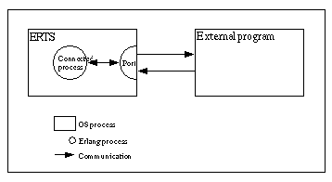
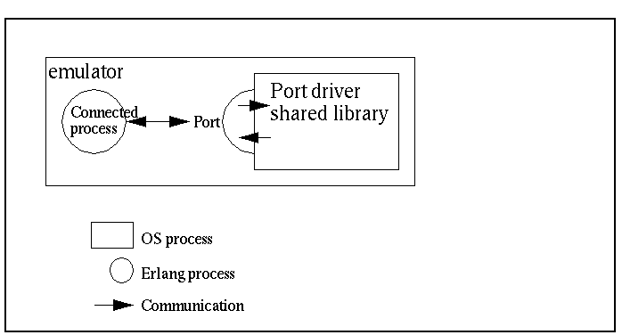
Ports
DEMO

Slide 8
Nifs
A Nif is a function that is written in c/rust/zig or other compatible programming languages instead of elixir/erlang,etc.. but appear as any function to the caller
Nifs are very efficient alongside port drivers because there are no context switches required.also good for synchronous relatively short calculations without side effects.should run in less than 1ms
But it is also the least safe, because a crash in a NIF brings the emulator down too.Use with caution as with port drivers!!
Some built in functions like length and some others as well as applications like crypto,tracing,zlib function all make use of nifs
solutions for long running nifs are yielding nifs,threaded nif,dirty nifs
DEMO

Slide 9
Distributed elixir
Distributed elixir comes into play when you have two or more elixir nodes communicating with each other and executing commands on the other node(s)
The program on the other node may be a c node,rust node,normal erlang node,erlang node running a port,nif etc...
All the nodes use the same erlang semantics for connecting to nodes,sending messages,error handling,remote execution although the encoding/decoding method/protocol may be different and the program on the other side different
DEMO

Slide 10
Libraries/Wrappers/
erlexec(https://github.com/saleyn/erlexec/)
porcelain(https://github.com/alco/porcelain)
unifex(https://github.com/membraneframework/unifex)
rustler(https://github.com/rusterlium/rustler)
zigler(https://github.com/ityonemo/zigler)

Slide 11
Last comments.
Do your own benchmarks
if application has real-time requirements/speed requirements which cant be avoided code as much as possible in elixir/erlang and then small bits which need speed using ports before nifs as last resort
You can also mix and see which scenario suits your application best(erlang node with or without port,with c node,with rest interface,etc..)
You have a lot of options for communication :)

Slide 12
Thank You.
Question time
Link to repository for source code/presentation as well as useful links
https://github.com/nayibor/outside_world_talk
http://erlang.org/doc/tutorial/overview.html
https://medium.com/@jlouis666/erlang-dirty-scheduler-overhead-6e1219dcc7
(long nif explanations and zig intro)https://www.youtube.com/watch?v=l848TOmI6LI
http://erlang.org/doc/man/erl_nif.html#lengthy_work

